Slide 1
Combating the infodemic: COVID-19 induced fake news recognition in social media networks
Abstract:
The model of this paper:
an early fusion-based method for combining key features extracted from context-based embeddings such as BERT, XLNet, and ELMo to enhance context and semantic information collection from social media posts and achieve higher accuracy for false news identification.
The Accuracy of this model:97%
Dataset:CONSTRAINT shared task-2021”

Slide 2
Introduction
The challenges of fake news identification,
Data from social media are abundant and growing, but the nature of these data are non-structural, incomplete, and noisy, making processing and understanding extremely difficult.
As fake news items are meant to deceive readers rather than provide objective claims, state-of-the-art methods for identifying false content fall short of better accuracy
features that distinguish one type of fake news may not work well for another.

Slide 3
The main contribution of this paper
Todevelopanearlyfusion-basedapproachforcombining key features extracted from context-based embeddings to improve the efficacy of fake news identification.
To develop various Recurrent Neural Network models, such as LSTM, BiLSTM, GRU, and BiGRU, with pre- trained BERT embeddings for fake news identification. In addition, their ensemble settings are also explored.
To develop a hybrid voting classifier by integrating the results of conventional machine learning algorithms and language models.
To develop a multi-level bit-wise operator-based classifier for fake news identification.

Slide 4
Related works
Fake news identification methods are typically classified into four classes:
News content-based
Social background based
Propagation-based
Information based

Slide 5
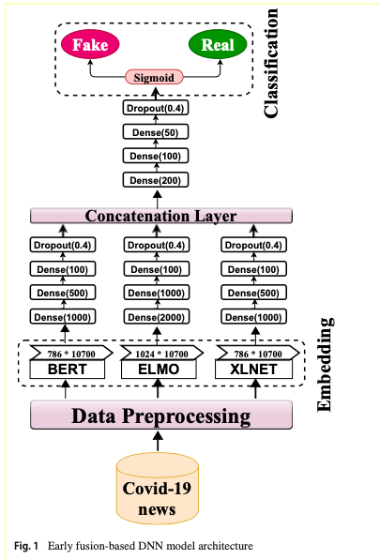
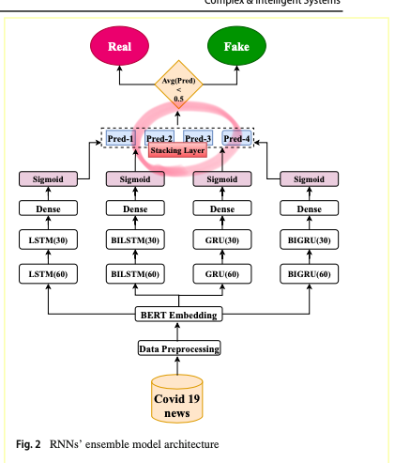
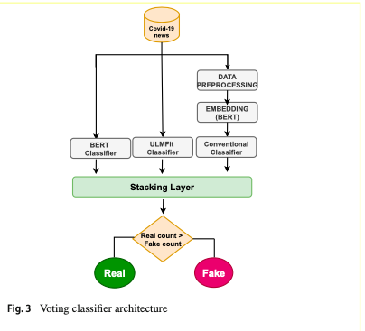
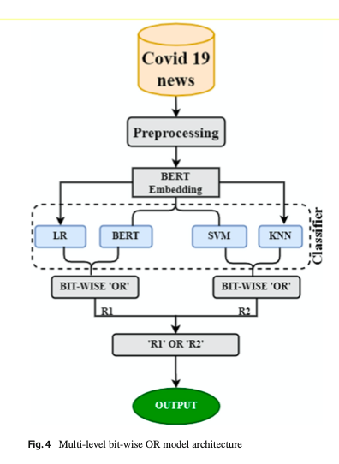
Methology
Model 1
Model 2
Model 3
Model 4

Slide 6
Results
Voting Classifier model comprised LR, BERT, and ULMFit were the best-performing models for detecting false news in our COVID-19 datasets(Model 3).
The overall study concluded that state-of-the-art language models and ensem- ble models outperform other machine learning techniques in recognizing fake news in the COVID-19 dataset

Slide 7
Discussion:
Disadvantages
Due to computational constraints, our model is trained on a limited data set. Future studies could broaden this to a bigger corpus
Our study did not account for code-mixed and native language statements. Therefore, there is always the possibility of expanding it to include a low resource regional and code-mixed language data set.

Slide 8
Future study
future work can extend our study into multimodal data containing both picture and text pieces. future research can also include mixed language code, and regional languages.

